Slide 1
E-Shopper Project
CS-425 Software Engineering Team 6:
Adeleke Oyebode Adeola 610516
Amit Bhattarai 610514
Ny Aina Michael Andriantsoa 610574
Lamhot Siagian 610517

Slide 2


Outline
Timeline
Software Development Process Methodology
Key Abstraction
System Architecture Diagram
Use Case Diagram
Use Case Description
Sequence Diagram
Collaboration and VOPC

Slide 3
Timeline
Week 1
Week 3
Week 2
Week 4
Requirement Analysis
Implementation and unit Testing
Inception |  | Elaboration |  |  | Construction |  |  |  |  |  |  |  | Transition
Deployment and Integration Testing
Design Analysis

Slide 4
Software Development Process :Agile
Using Trello
Daily update
Iterative Process

Slide 5
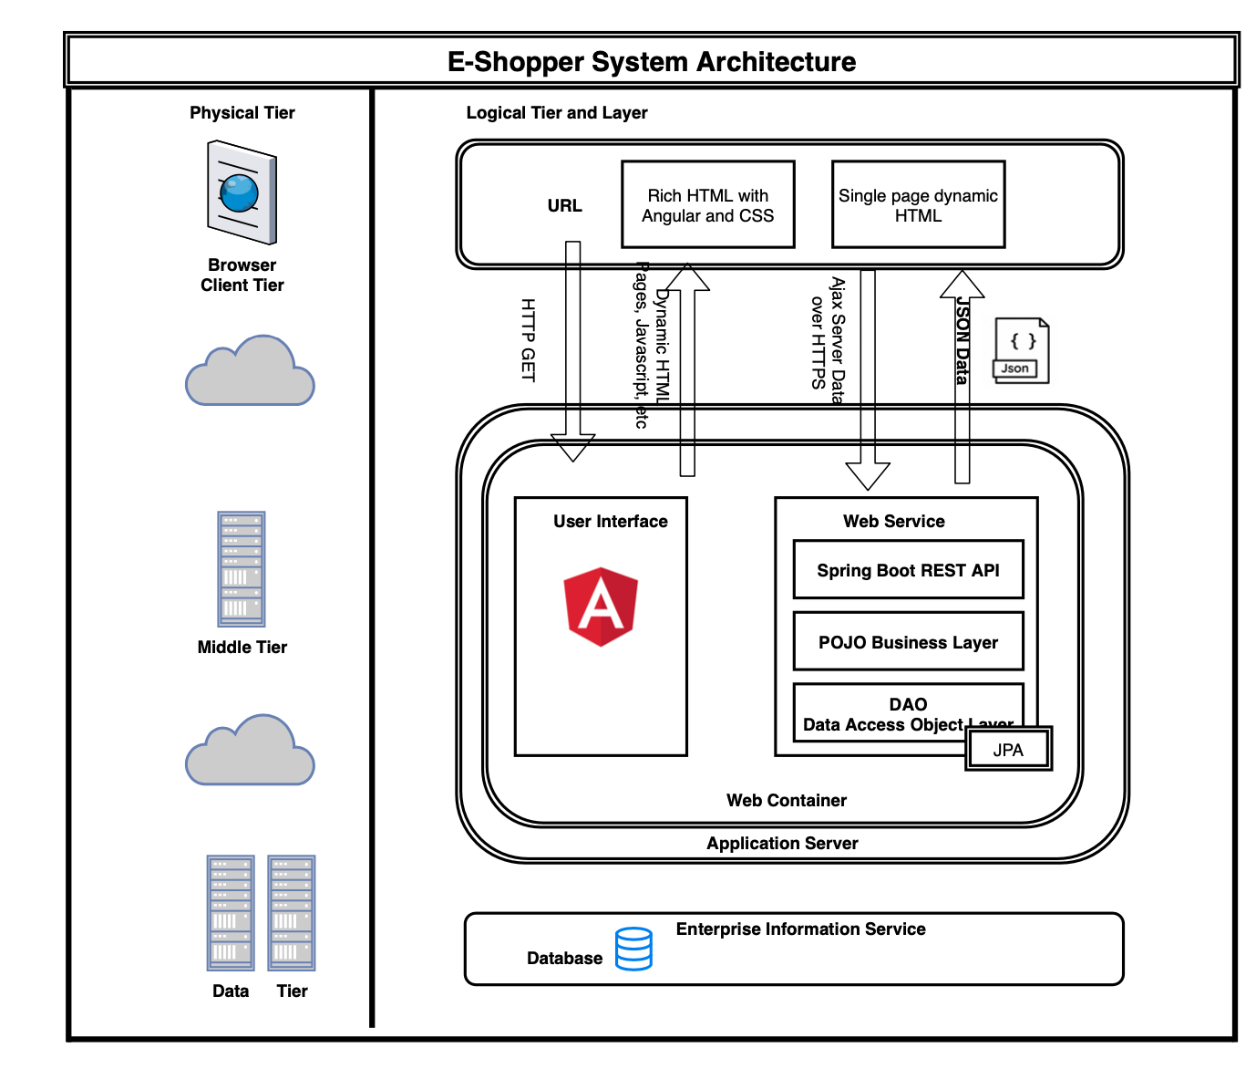
System Architecture Diagram
Technologies
Angular
Mysql
Spring Boot
Spring Security
Bootstrap
Thymeleaf

Slide 6
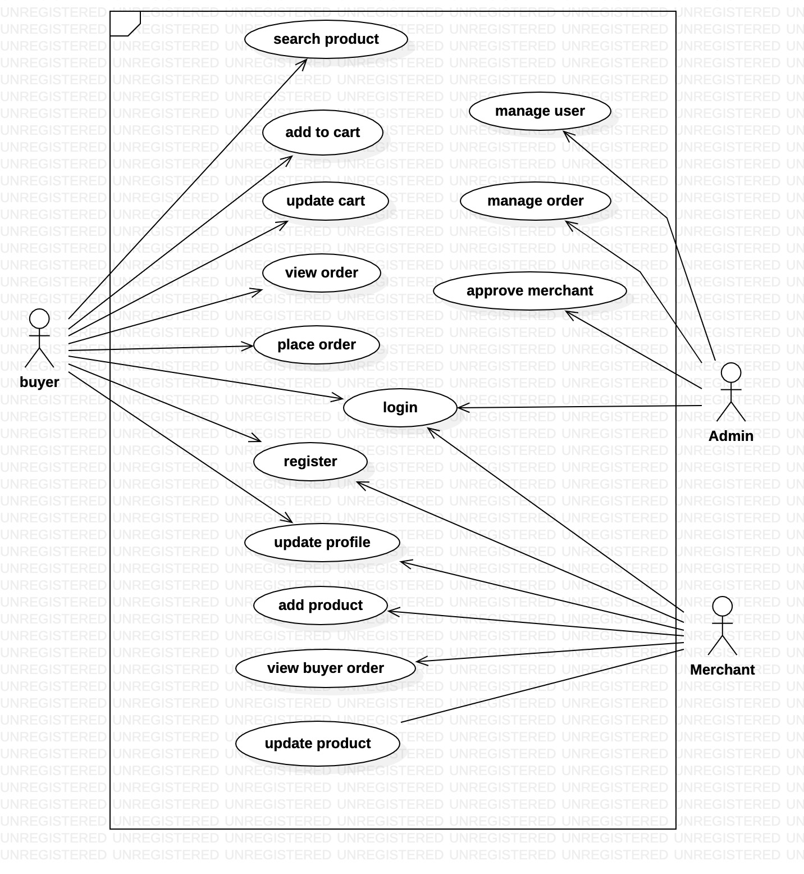
Use Case Diagram

Slide 7
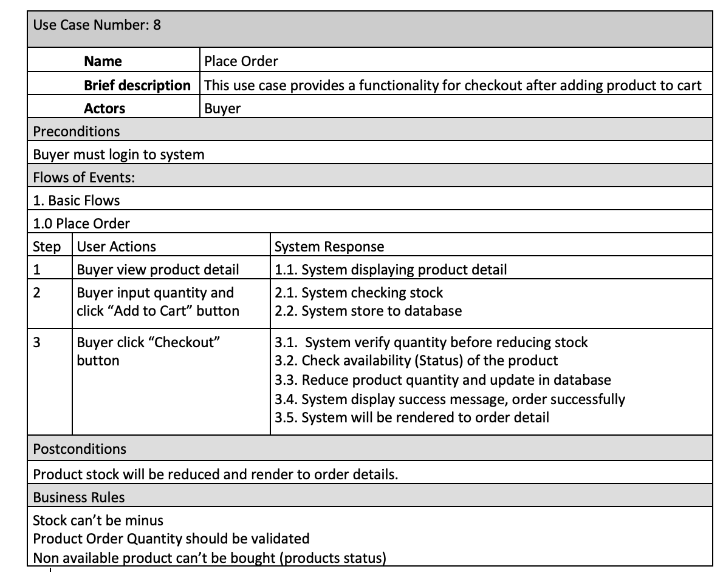
Use Case Description

Slide 8
Key Abstraction
Buyer
Seller / Merchant
Product
Category
Order
Order Item

Slide 9
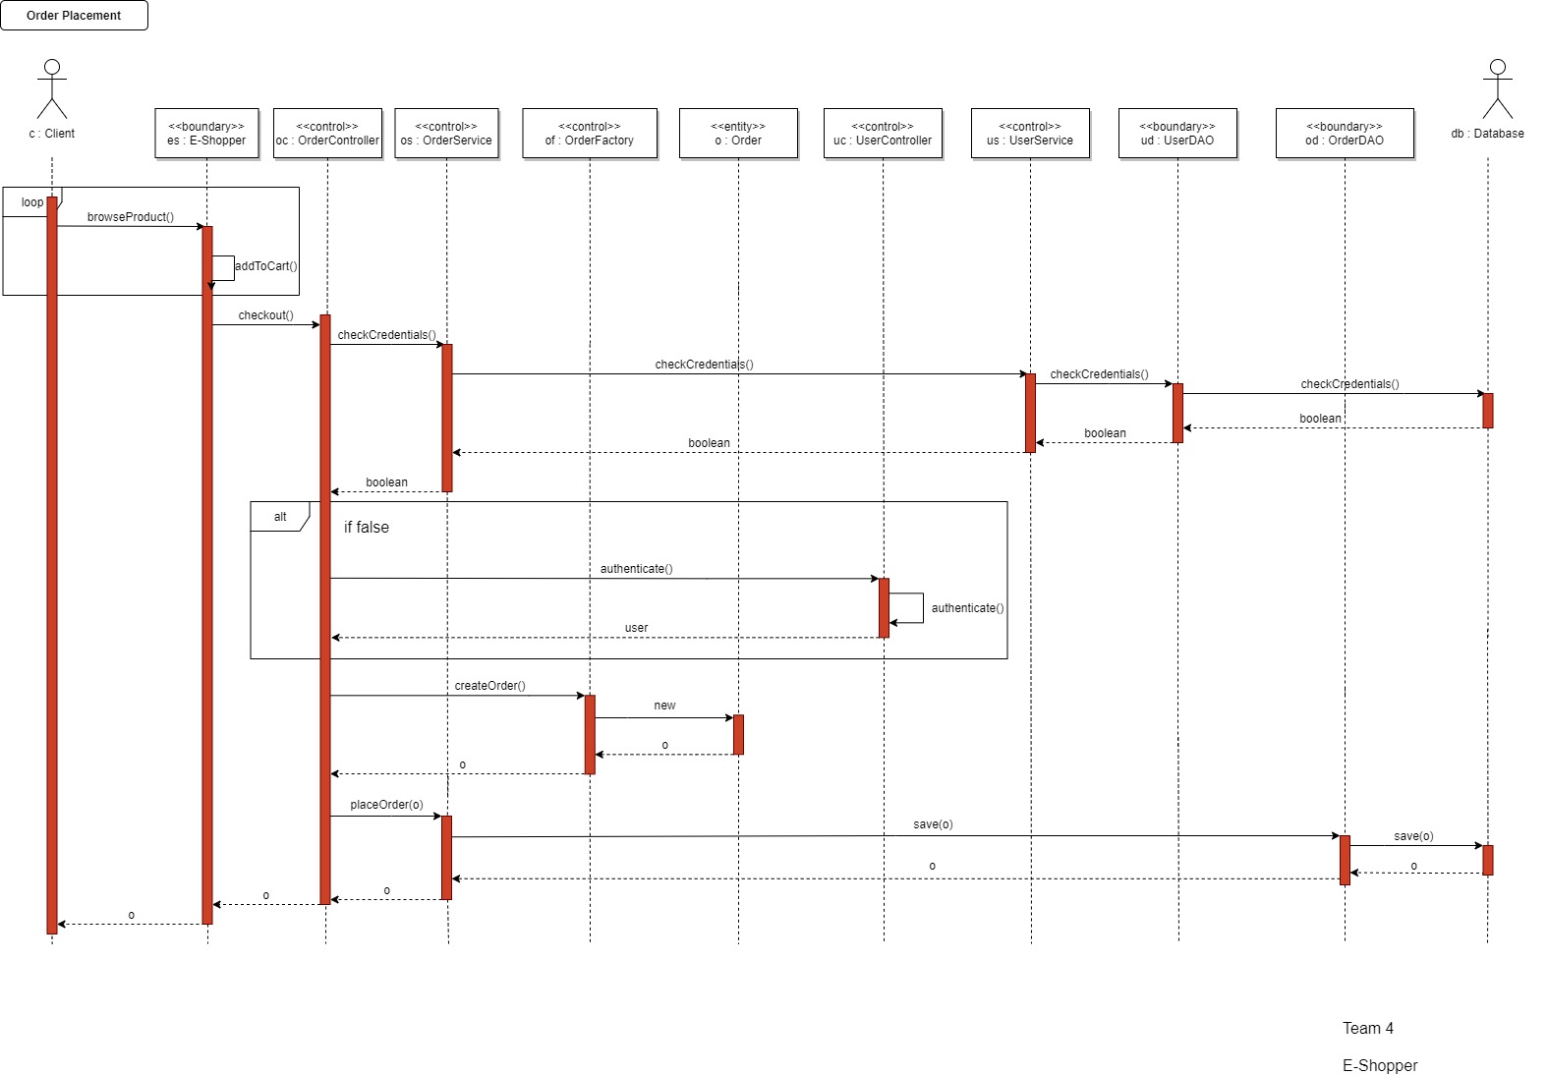
Place Order Sequence

Slide 10
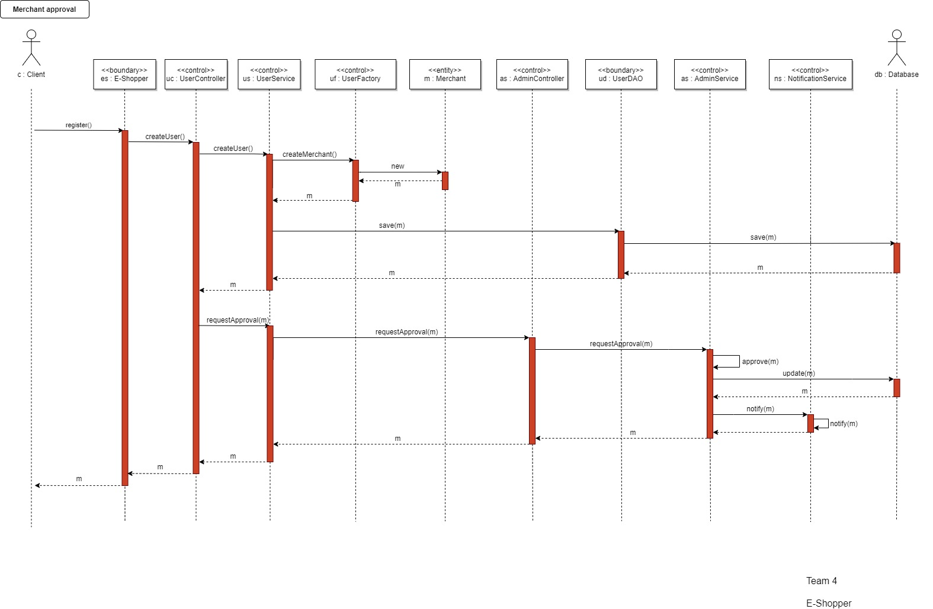
Merchant Approval Sequence

Slide 11
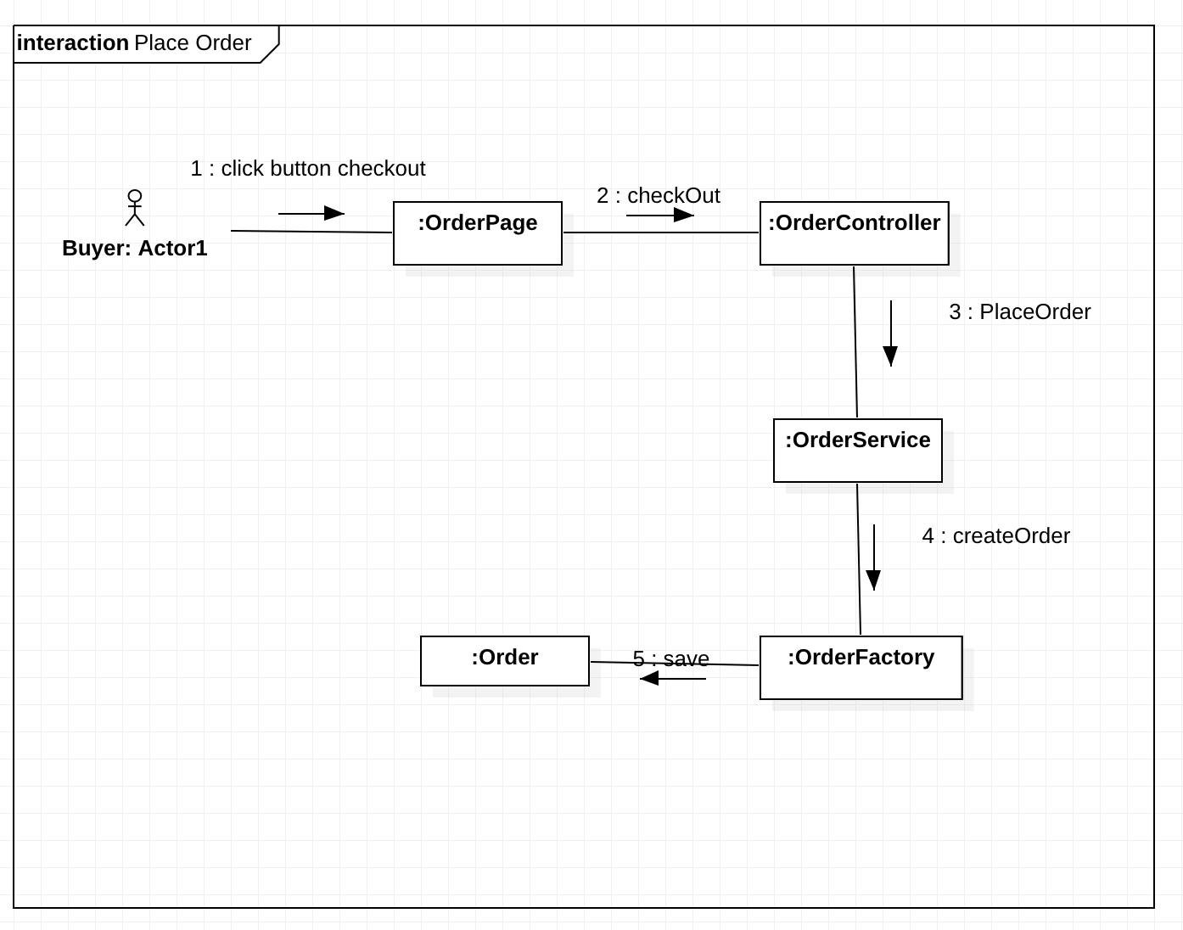
Collaboration Diagram Place Order

Slide 12
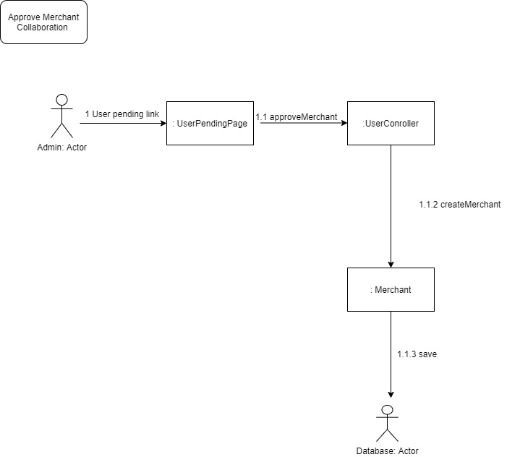
Collaboration Merchant Approval

Slide 13
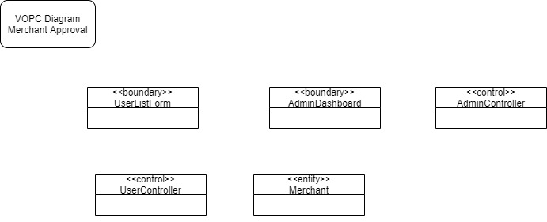
VOPC Merchant Approval

Slide 14
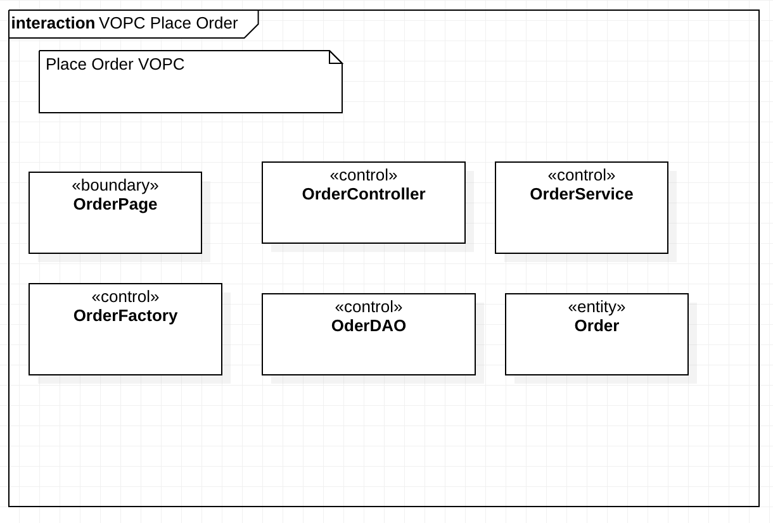
VOPC Place Order

Slide 15
Thank You!

